Slide 1

Finding Peace in Our Relationships

Slide 2



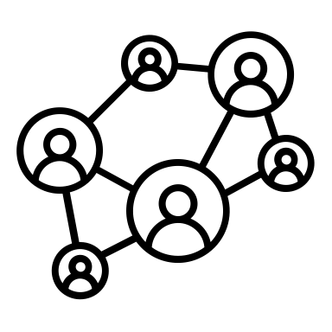
Our story forms how we feel about ourselves. What/Who in your story helped you? What/Who in your story hurt you? (toxic shame)

Slide 3
The Power of Toxic Shame
Healthy Shame:
“A feeling of our core boundaries and limitedness…nourishing in that it moves us to seek new information and learn new things.”
Toxic Shame:
Lack of healthy emotional boundaries, crushing of personal autonomy, dividing within oneself, creation of false-self to cover flaws, emotional stagnation, “exposure” without any defense
(John Bradshaw)

Slide 4
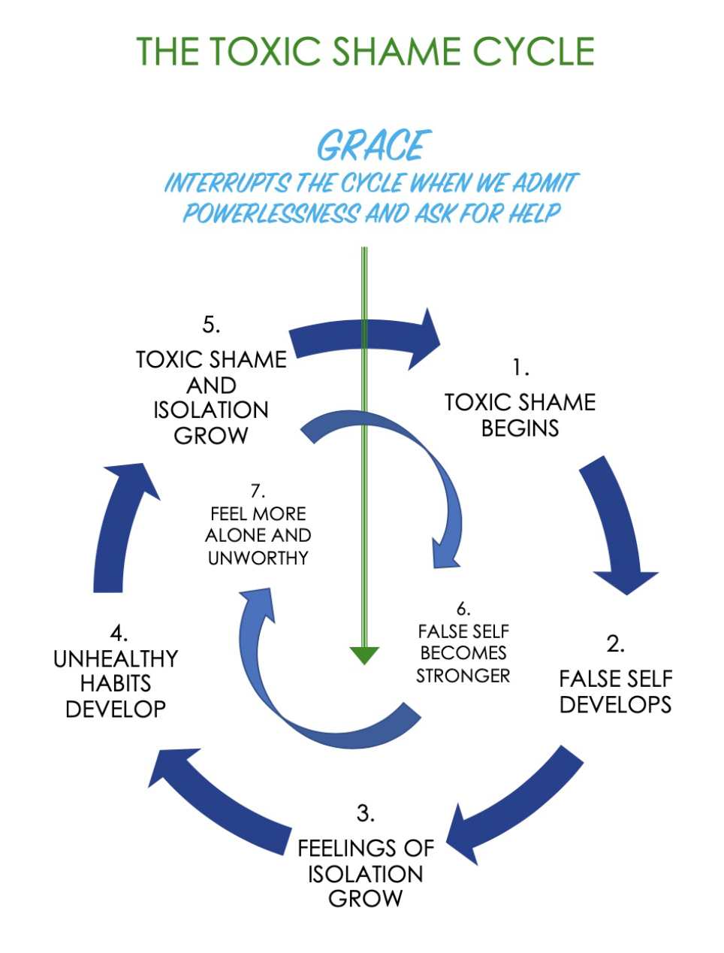

Slide 5

Relationship Patterns: Finding the Familiar, Even When We Aren’t Trying

Slide 6
How Do We Recognize a Healthy Relationship?
Initiative:
Calls, reaches out, expresses care, invites others to share, expresses wants and needs, takes responsibility to maintain relationship
~ Patrick Carnes
Presence: emotionally available to others, listens, attends, clear about reactions, spends time with others, notices what is happening with others, accepts attention of others
Completion:
Builds trust by finishing things, works for closure on problems, responds to others’ needs, expresses appreciation to others
Vulnerability:
shares process of thinking and feeling, involves others in discussion, allows feedback from others, allows others to see fears and struggles
Nurturing:
cares for others, makes caring statements, empathizes with others pain, supportive, encouraging, offers suggestions, affirms the value of others, does things to help others
Honesty:
owns thoughts and feelings, clear about priorities and values, specific about disagreements, provides feedback when asked, admits flaws and mistakes, is fully known by those closest to them

Slide 7


Relationship Boundaries
Because of toxic shame, we can lose sight of where we stop and someone else begins.
We are responsible to others and for ourselves.
Denying ourselves to do for others what they cannot do for themselves is showing sacrificial love.
Doing for others what they can do for themselves is not helping. It is actually hurting you and them.
Our boundaries should be like a picket fence around a house. It keeps the bad out and the good in. But it does not keep us isolated. It has a gate that allows us to let things in and let things out.
~ Henry Cloud and John Townsend, Boundaries

Slide 8

Reflection
What is your most challenging relationship right now? Why?
If you look at that relationship, are there healthy aspects missing? (initiative, presence, completion, vulnerability, nurturing, honesty)
What small change could you make today to make that relationship better or make your life better when looking at that relationship?
Who in your life right now do you feel responsible for that is NOT your responsibility?
Is there anyone who feels responsible for you but are not responsible for you?

